Slide 1
Creating Reports
Paul kisambira

Slide 2
Reports provide information found in the database in a useful way. In this they are similar to queries.
Reports are generated from the database's tables or queries. They can contain all of the fields of the table or query or just a selected group of fields. Reports can be static or dynamic. Static reports contain the data in the selected fields at the time the report was created. Dynamic reports can be updated to show the latest data.

Slide 3
Creating a static report
Certain questions need to be asked before creating the report:
What information do we want in the report?
How do we want the information arraigned?
What fields are required to provide this information?
Will a query have to be created because these fields are in different tables?
Are there any calculations required in the data before being added to the report?

Slide 4
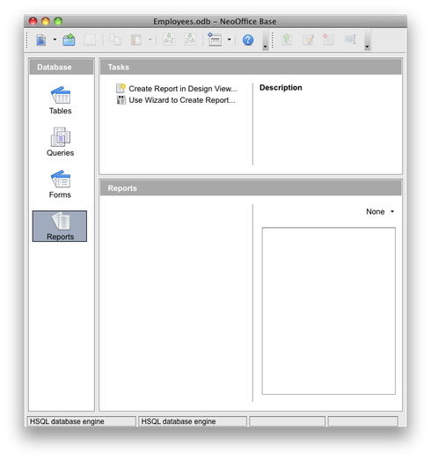
Steps in creating a Report

Slide 5
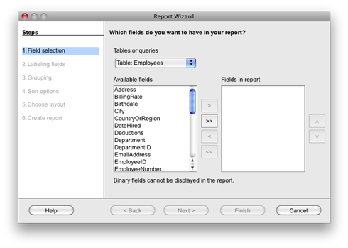
Step 1(select fields for the report)
This is like the form. We choose what fields that we want on this report by clicking on them and clicking the move button, >. We can also click the >> button which moves them all. Click next when you got the fields that you want for this report.

Slide 6
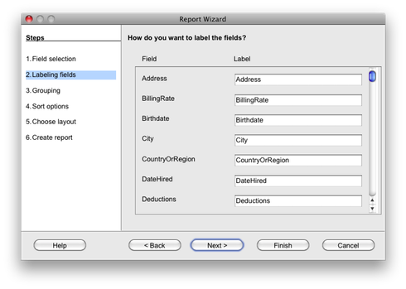
Step 2
Now you can set what you want the report to use as a label for the fields. Here is where you make the field names more human readable. Click next when you get what you want.

Slide 7
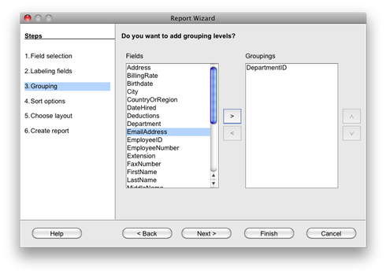
Step 3
The next page is to select the field that you want to use for any groups you want to build. Make sure that if you use more than one field that the more important field is on top. When you get what you want, click next.

Slide 8
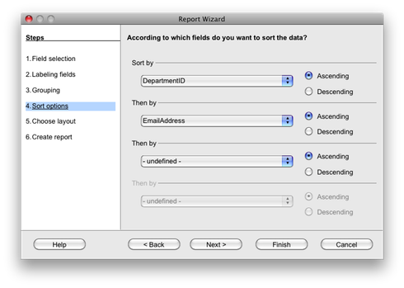
Step 4
Now you need to select any additional fields that you wish to sort by. Once you get everything the way you want it, click on next.

Slide 9
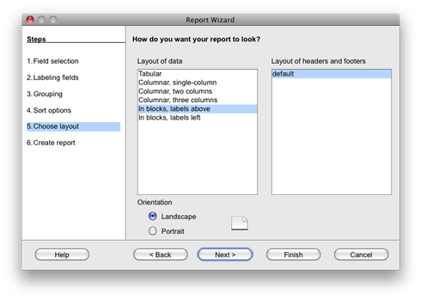
Choose one of the layouts to build a report you want. You can move the dialog away from the design surface if you want to see what it will look like. When you get it the way you want, click on next.

Slide 10
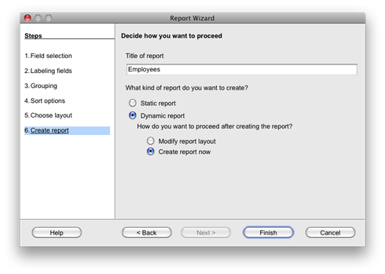
Step 5
Static report is a report that is frozen with data at a certain point. If you want to run the report with new data then you want a dynamic report. Make sure that you give the report a good name. When everything is ready then click on finish.

Slide 11
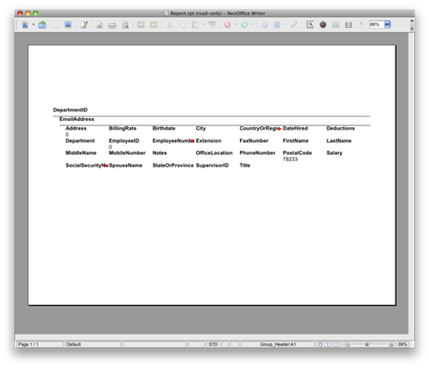
End Result

